Slide 1
Meteoroid Impact Analysis on EMM Data
Date of Impact: 24th December 2021
Location of Impact: 24.8⁰N, 196⁰E

Slide 2
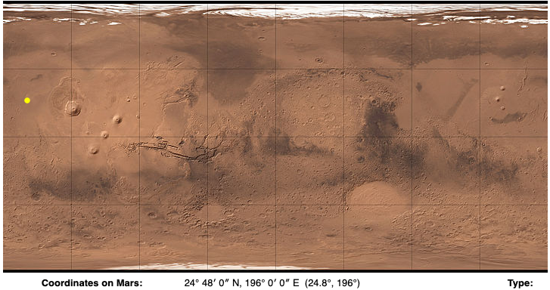
Impact: Amazonis Planitia
Impact Site: Amazonis Planitia, centered at 24.8°N 196.0°E
Impact Date: Christmas Eve / 24-12-2021

Slide 3
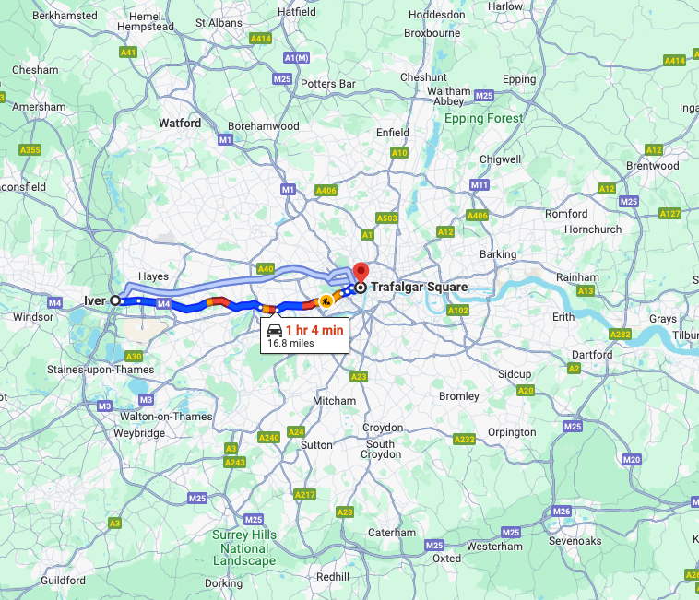
Impact Radius
Impact Radius: blast zone around the crater equivalent in size to the area inside London’s M25 motorway.
A dark halo of material surrounding the crater churned up by the airblast measures at least 23 miles (37 kilometres) across

Slide 4
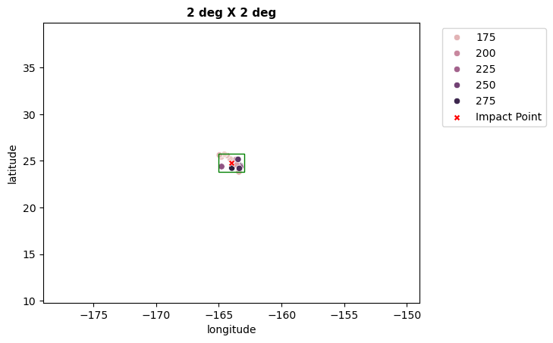
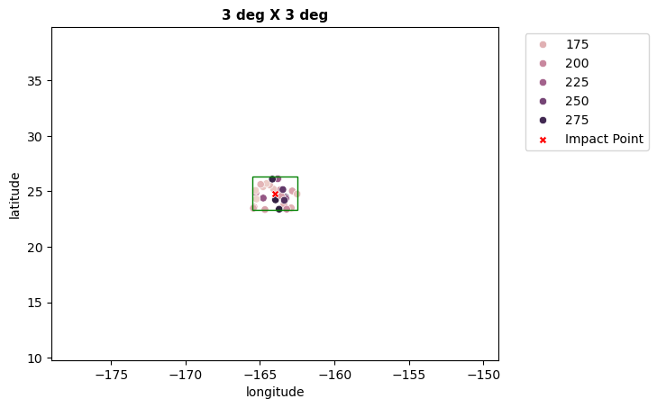
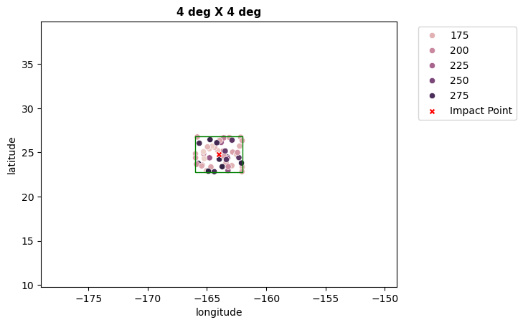
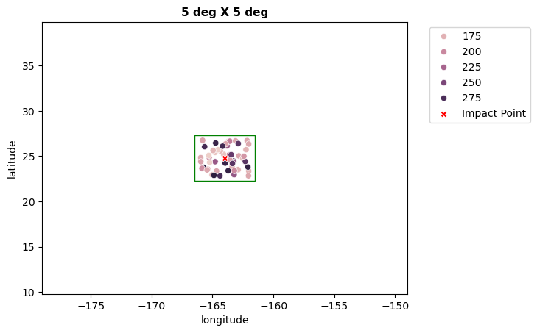
EMM Data grids used for analysis
EMM did not directly cover the area around the impact on 24th / 25th of December. Therefore it is not possible to see the real time effect of the impact with readings from EMM. Our approach then is to examine the readings available within a grid around the impact location for a date range starting from 15th November 2021 to 5th Jan 2022.
Each degree of latitude / longitude corresponds to approximately 59 km on Mars

Slide 5
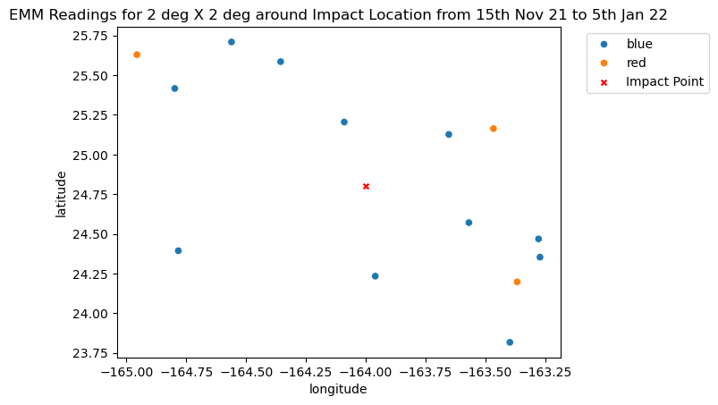
EMM Data grid – 2 deg X 2 deg (max distance from impact point 71 km)
26th Dec 2021
Time: 1.735
4th Jan 2022
Time: 9.05
26th Dec 2021
Time: 9.5
Observation:
We see that there are only 3 readings within a +-1 degree of impact location post 24th December from EMM.
Note: Legend [Blue: Before 24th December 18:00, Red: After 24th December 18:00]

Slide 6
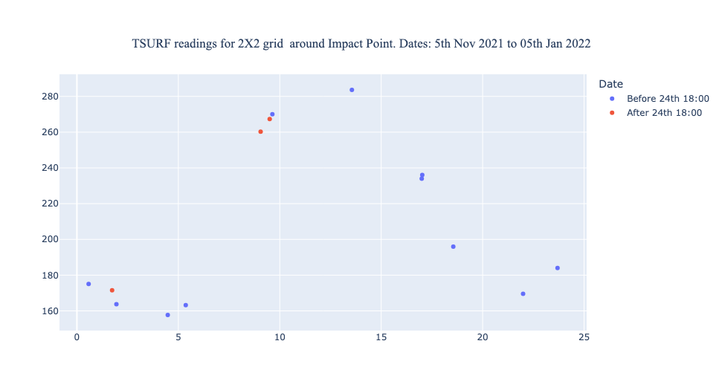
EMM Data grid 2X2 – Diurnal TSURF Readings
26th Dec 2021
Time: 9.5, 49 km
4th Jan 2022
Time: 9.05, 36km
26th Dec 2021
Time: 1.735, 71km
Observations:
The closest reading in time recorded from EMM post impact, is for the 26th of December at the local time of 1.735h at a distance(haversine) of approximately 70.9 kilometer. This shows a higher TSURF reading than the readings from before 24th Dec (in blue). We will further verify with the KRC expected values to see how far it is from the expected temperature.
The closest reading in distance is similarly for the 4th of January 2022, at a distance(haversine) of 35.78km from impact location. We will again check the KRC output for expected values of TSURF for this location

Slide 7
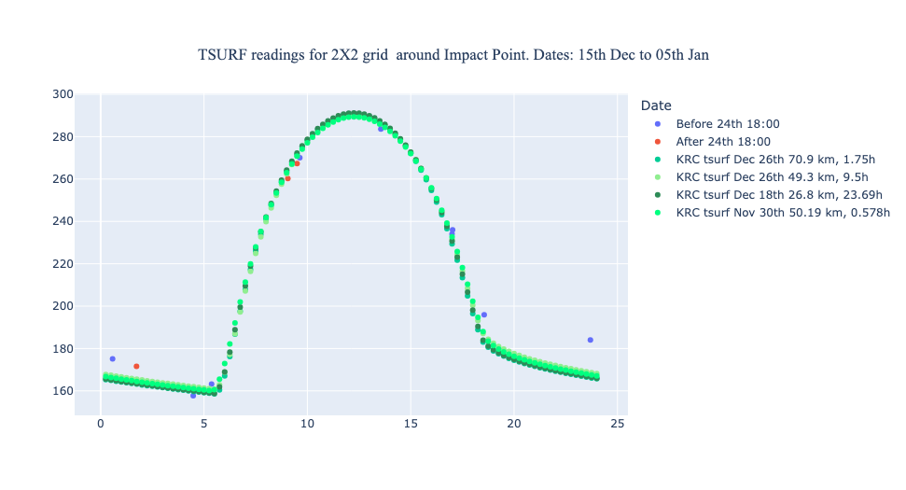
EMM Data grid 2X2 – Diurnal TSURF Readings with KRC expected values for selected points
26th Dec 2021
Time: 9.5, 49km
4th Jan 2022
Time: 9.05, 36km
30th Nov 2021
Time: 0.578, 50km
18th Dec 2021
Time: 23.69, 24km
26th Dec 2021
Time: 1.735, 71km
Observations:
We see that the reading closest in time to Impact, is higher than the KRC output for that location. However we also find earlier readings that have gone above the KRC threshold, and we need to inspect these points further
We see that that the 26th December reading, at a distance of 49.3 km at 9.05h local time in the morning, is well under the KRC expected value for TSURF.
We also find that there are additional deviations from the KRC expected values pre-impact. These will need to be inspected further to understand the underlying causes for such behaviour.

Slide 8
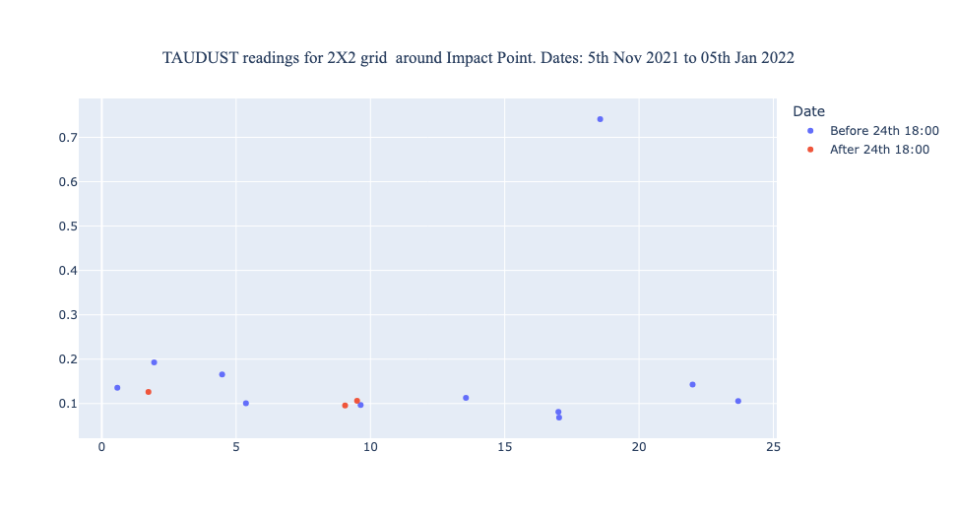
EMM Data grid 2X2 – Diurnal TAUDUST Readings with KRC expected values for selected points
26th Dec 2021
Time: 9.5, 49km
4th Jan 2022
Time: 9.05, 36km
16th Nov 2021
Time: 18.55, 26.8
14th Dec 2021
Time: 1.97
26th Dec 2021
Time: 1.735, 71km
Observations:
The TAUDUST for the 26th December at a distance of 49 km from the Impact, shows a slightly higher reading than the readings for before the 24th December. This could be related to the slightly lower readings of TSURF compared to the KRC expected output. This has to be inspected further.
We see that the 26th December reading, the earliest available reading at a distance of 71 km from impact is nestled within the blue pre impact readings. We see that the highest reading within that one hour from 1 to 2, was on 14th December 2021, and we can further inspect if there was an unusual dust activity at that time.
Another pre-impact high dust reading is for the 16th of November, the TSURF for this point however is within the KRC expected value and shows no abnormality.

Slide 9
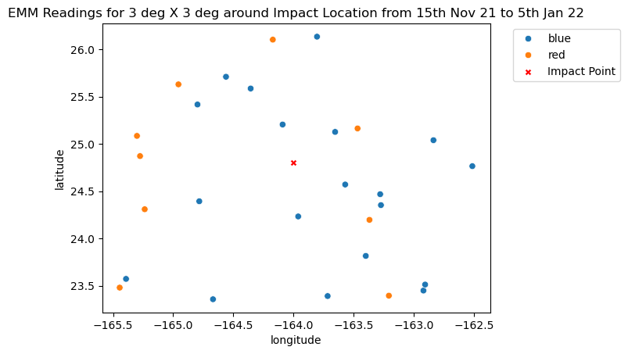
EMM Data grid – 3 deg X 3 deg (max distance from impact point 110km)
4th Jan 2022
Time: 9.05
26th Dec 2021
Time: 9.5
Observations:
With the increase in grid size, we get some additional readings post impact.

Slide 10
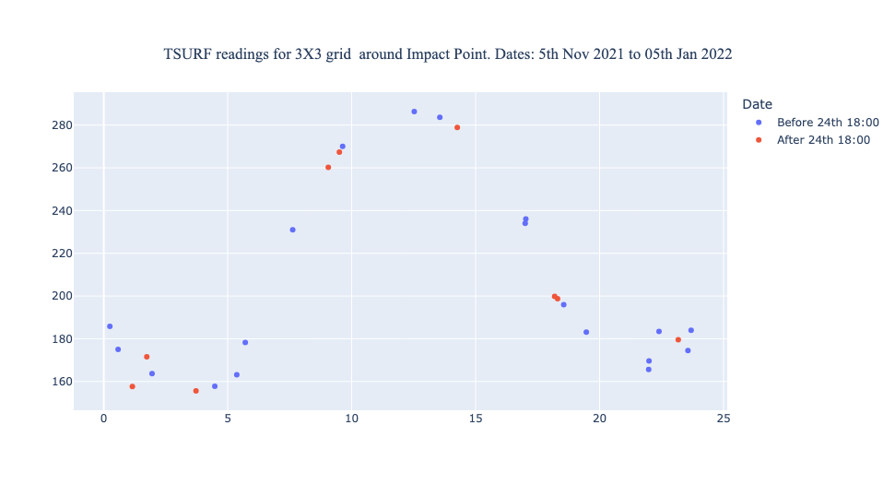
EMM Data grid 3X3 – Diurnal TSURF Readings
26th Dec 2021
Time: 14.25, 77km
4th Jan 2022
Time: 1.15, 71.8km
4th Jan 2022
Time: 3.7, 72.6 km
Observations:
With the grid extension, we get a few more readings post 24th December, and the closest among them in time to the impact is the reading on 26th December , at 14.25 local time and at a distance of 77 km from impact. It does not look to be higher than usual. The next closest in time is the reading of 27th December at 18.3 local time and at a distance of 93.5 km from impact. This reading too does not look like it is deviating much from expected values at first inspection.
We also see a night time reading for the first time post impact on the 28th December at 23.17 local time and at a distance of 110.3 km. This reading is nestled between other pre impact readings.
There are 2 readings for the 4th of Jan which show a lesser TSURF reading compared to the points around, we can inspect the KRC expected output for these readings

Slide 11
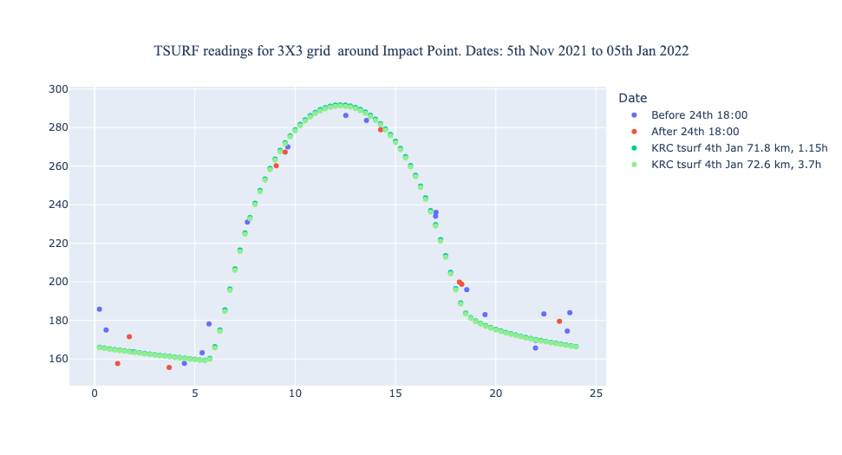
EMM Data grid 3X3 – Diurnal TSURF Readings
26th Dec 2021
Time: 14.25, 77km
4th Jan 2022
Time: 3.7, 72.6km
4th Jan 2022
Time: 1.15, 71.8km
Observations:
We see that these points just after midnight local time are showing lesser TSURF than KRC expected output. This could possibly be due to increased dust.

Slide 12
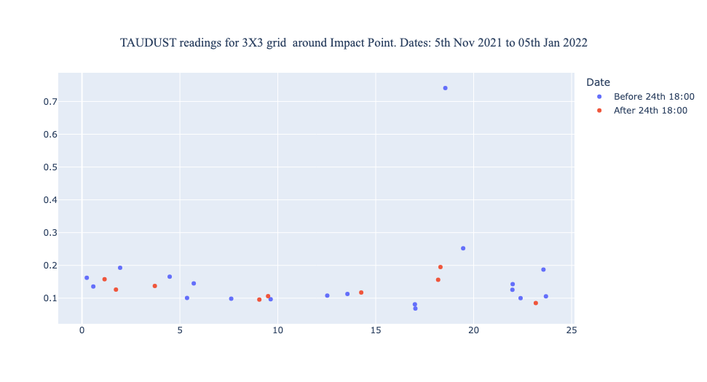
EMM Data grid 3X3 – Diurnal TAUDUST Readings
26th Dec 2021
Time: 14.25, 77km
4th Jan 2022
Time: 1.15, 71.8km
27th Dec 2021
Time: 18.3, 93.5km
4th Jan 2022
Time: 3.7, 72.6km
Observations:
We see that taudust is slightly higher for these points from the 26th and 27th December at distances 77km and 93.5 km.
We inspect the 4th Jan lesser than normal TSURF readings for any abnormal TAUDUST values, they are higher than 0.1, however again with pre impact readings of higher TAUDUST.

Slide 13
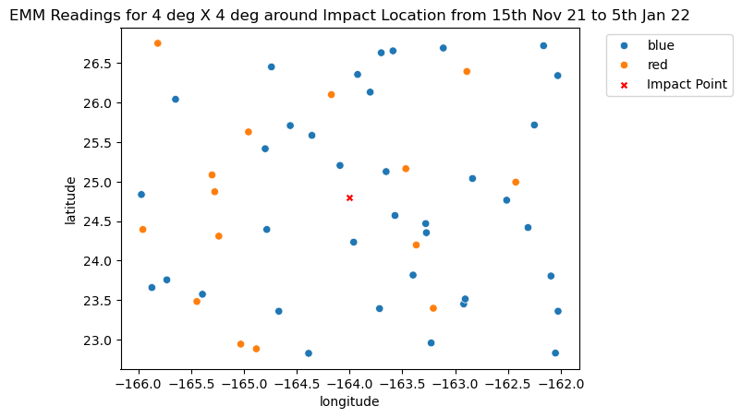
EMM Data grid – 4 deg X 4 deg (max distance from impact point 157.28)
4th Jan 2022
Time: 9.05
26th Dec 2021
Time: 9.5
Observations:
With the increase in grid size, we get some additional readings post impact.

Slide 14
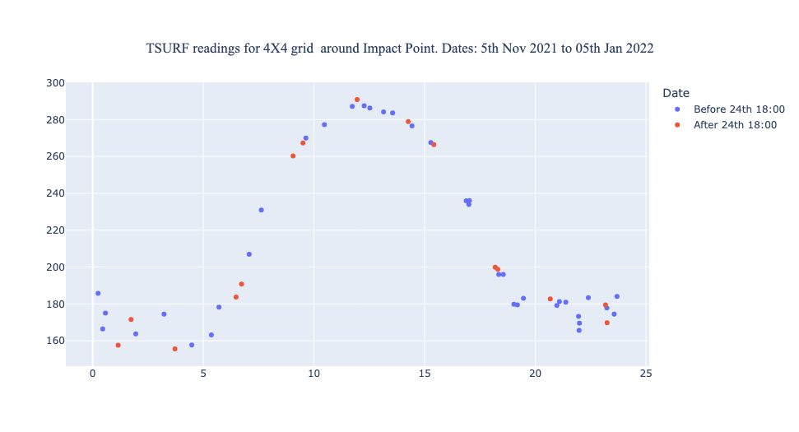
EMM Data grid 4X4 – Diurnal TSURF Readings
26th Dec 2021
Time: 14.25, 77km
27th Dec 2021
Time: 18.3, 93.5km
Observations:
With the grid extension, we get a few more readings post 24th December, and the closest among them in time to the impact is the reading on 26th December , at 14.25 local time and at a distance of 77 km from impact. The next closest in time is the reading of 27th December at 18.3 local time and at a distance of 93.5 km from impact.
We also see a night time reading for the first time post impact on the 28th December at 23.17 local time and at a distance of 110.3 km

Slide 15
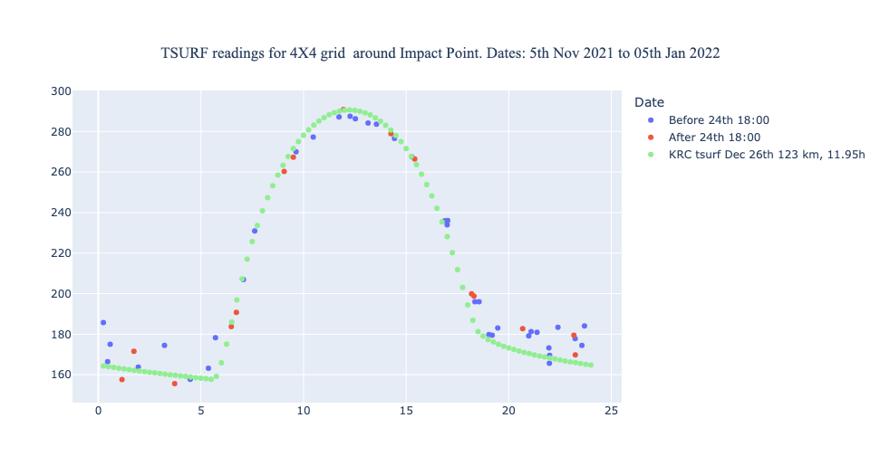
EMM Data grid 4X4 – Diurnal TSURF Readings
26th Dec 2021
Time: 14.25, 77km
27th Dec 2021
Time: 18.3, 93.5km
Observations:
The reading from 26th December which has shown the highest TSURF value so far falls exactly on the KRC expected value for that location, and local time.

Slide 16
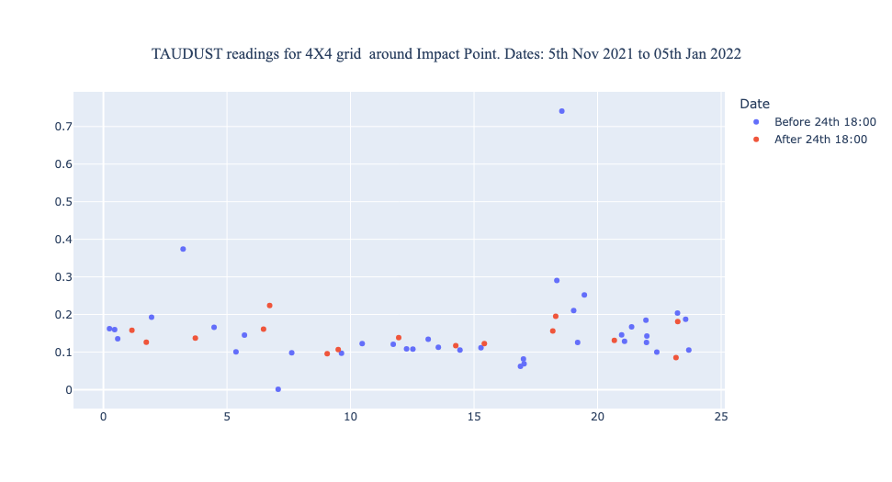
EMM Data grid 4X4– Diurnal TAUDUST Readings
26th Dec 2021
Time: 14.25, 77km
27th Dec 2021
Time: 18.3, 93.5km
Observations:
We see that taudust is slightly higher for these points

Slide 17
Thank You

